Slide 1


Pax challenge @

Slide 2

Challenges
Average age of life insurance buyers are 43 years old¹
Average monthly cost for life insurance is 100 CHF/month²
Average attention span is 47 seconds³
Younger generations do not have patience
Need a friendly way to interact
Why not have a central index of truth?
BEAR FACT:
A 71-year-old woman from California, became the state's first recorded fatality from a black bear attack.
https://lewisellis.com/industries/life-insurance-annuities/the-characteristics-of-people-who-buy-life-insurance/
https://en.comparis.ch/lebensversicherung/default
https://www.apa.org/news/podcasts/speaking-of-psychology/attention-spans
Notes:
Why did we choose the challenge?

Slide 3
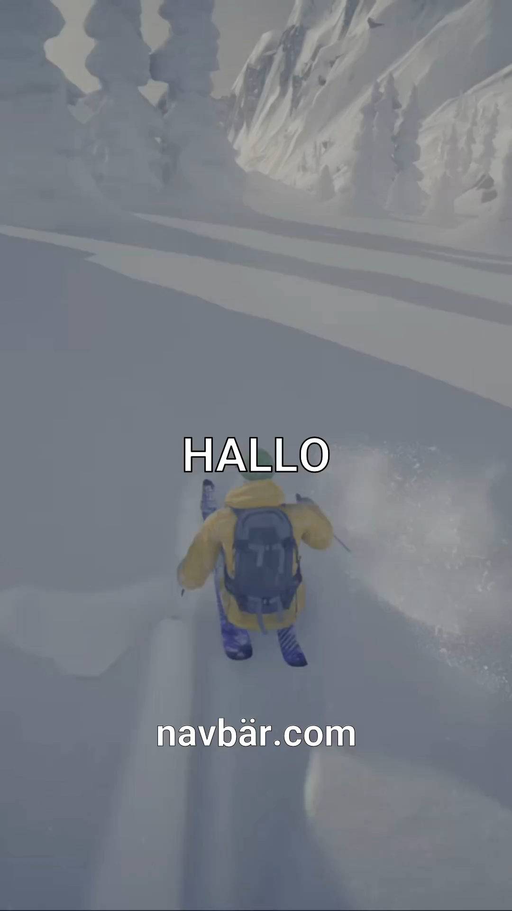

How do we get attention?
Targetted ads using TikTok¹
Gender
Age: 18-24, 25-34, 35-44 (our targets)
Location (specific as city): Basel
Interests (tailored videos)
Cell phone carrier: insure living in CH
Automatic AI generated videos →
BEAR FACT:
A teenager in Romania was mauled to death by a bear
while hiking in the Bucegi mountains.
https://ads.tiktok.com/help/article/ad-targeting

Slide 4

navbar.ch
Chat with NAVBÄR now →
Private user specific sessions
No saved data (GDPR by default)
What are we offering from PAX?
Disability insurance
Life insurance
Savings life insurance
Children's insurance
Payout plan
BEAR FACT:
The "Ninja Bear," officially designated as "OSO18," was notorious in Japan's Hokkaido region
for attacking dozens of cows and evading capture for years

Slide 5

What is NAVBÄR?
Friendly chat bear to understand and choose the right insurance
Indexed webpage and documentation to provide detailed responses to questions
Microsoft AI Search, RAG, and GPT-4o
K8s, Node.js, WebSocket, React, and Mantine
BEAR FACT:
Grizzly No. 399, a beloved bear in Grand Teton National Park, was killed by a vehicle,
leading to a community vigil in her honor.

Slide 6


Team
Day 1
Fabrizio Parrillo
Alex Rovner
Niluka Piyasinghe
Normand Overney
Kevin Yar
Day 2
BEAR FACT:
Hugh Glass, a 19th-century fur trapper, survived a grizzly bear mauling and crawled over 200 miles to safety,
inspiring the film "The Revenant."

